Slide 1
Camila Sleep App
Sprint 4 Retrospective
TEAM 4 - Haruko Okada, Sergio Martelo, Mingi Lee, Dylan Laurianti
March 20th, 2024
Notes:
10

Slide 2
Sprint Overview
This sprint we tackled some of the most challenging issues, including local mobile db, sleep plan/tracking API, coach onboarding, notifications, and PDF uploading
Due to the high uncertainty and many issues carried forward to sprint 5, this sprint had lower story delivery than our previous sprints
We are now more knowledgeable moving forward with our only significant remaining sources of uncertainty being chat & deployment
Notes:
Sergio 50

Slide 3
MVP Summary
For the mobile app, we have set up the home screen with styling, medicine tracking feature, and event view feature.
For the web app, we integrated generating sleep plans with the backend and created UI workflow for the owner to assign and unassign clients to coaches.
Notes:
Sergio 50

Slide 4
What went well?
All the sleep tracking is finally done!
The mobile deployment is set up!
Able to assign clients to coaches!
Improvements in the backend testing so that it accounts for more complicated requests!
Improvements in web testing strategies!
Meetings with client!
Design feedback from client!
Notes:
Sergio 50

Slide 5
What could have been better?
Blocked Tasks
Everyone had a high complexity task in a new area we have not worked on yet
Have tasks that are carried on from previous sprints
Issues had to be added mid-sprint to progress towards blocked tasks
Separation of responsibilities caught up to us a bit
We forgot to update Jira tickets as we worked on them :(
Notes:
Sergio 50

Slide 6
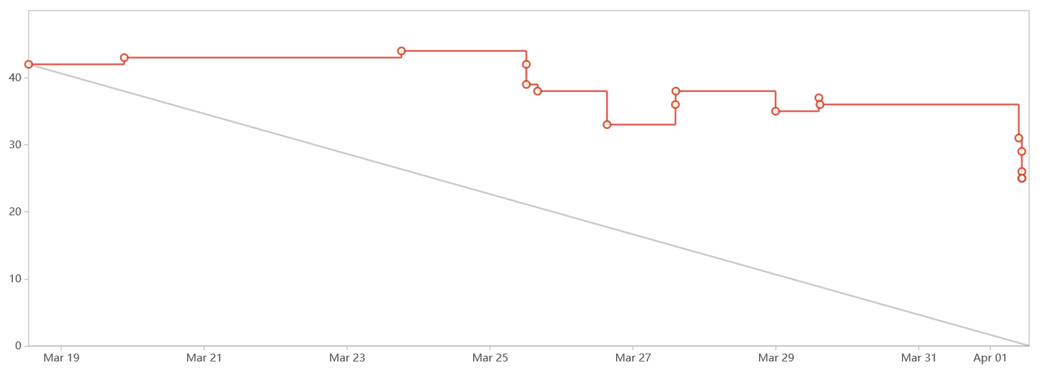
Burndown Chart

Slide 7
What will we do differently?
Consider next 2 weeks’ schedule when assigning tasks
Assign less points if you have tasks left from last sprint
Also, we have to account for outside events better when assigning tasks, i.e. midterms, grading, etc.
Notes:
Sergio 50

Slide 8
Action Items
Deployment
Chat
PDF upload/download
Mobile local database
Auth0/Postgres handling of coach initialization
View sleep statistics
Notes:
Haruko

